Slide 2



Using mutation testing to improve your JavaScript tests
Twitter
#techdaysnl
Simon de Lang

Slide 3
Agenda
Unit testing
Mutation testing
Stryker

Slide 4
Unit testing

Slide 5
Unit testing
function isOldEnough(user) {
return user.age >= 18;
}
// Test
var user = { name: 'Simon', age: 24 };
assert.equal(isOldEnough(user), true);
Notes:
Let’s write a test for this code, it’s easy!
Now, are we done with writing our test?

Slide 6
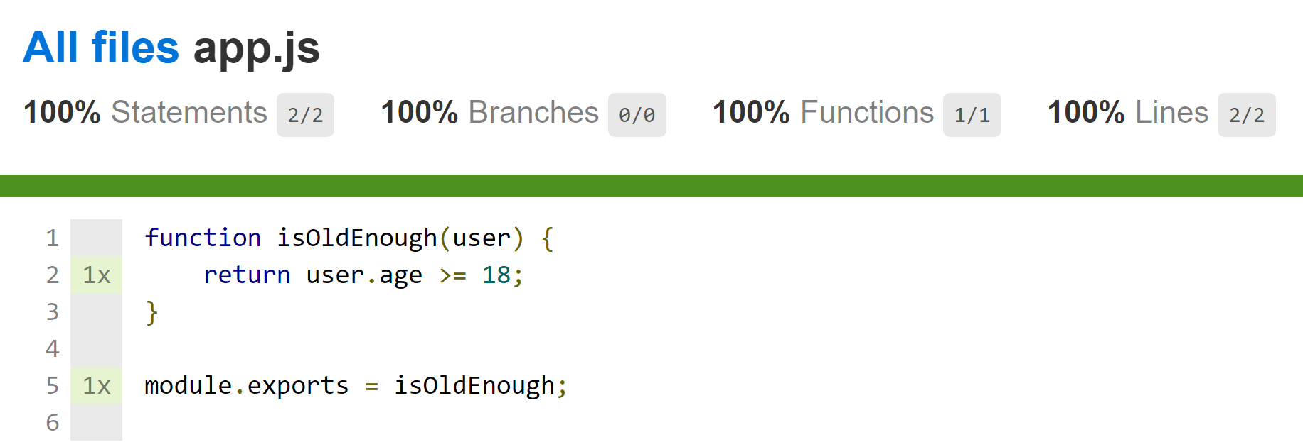
Notes:
100%! We’re done!

Slide 7
Testing your app
import { getLogger } from 'log4js';
import * as _ from 'lodash';
import { RunResult, CoverageCollection, StatementMap, CoveragePerTestResult } from 'stryker-api/test_runner';
import { Location, StrykerOptions, File, TextFile } from 'stryker-api/core';
import { MatchedMutant } from 'stryker-api/report';
import { Mutant } from 'stryker-api/mutant';
import TestableMutant from './TestableMutant';
import StrictReporter from './reporters/StrictReporter';
import { StatementMapDictionary } from './coverage/CoverageInstrumenter';
import { filterEmpty } from './utils/objectUtils';
import SourceFile from './SourceFile';
export default class MutantTestMatcher {
private readonly log = getLogger(MutantTestMatcher.name);
constructor(private mutants: Mutant[], private files: File[], private initialRunResult: RunResult, private statementMaps: StatementMapDictionary, private options: StrykerOptions, private reporter: StrictReporter) {
}
private get baseline(): CoverageCollection | null {
if (this.isCoveragePerTestResult(this.initialRunResult.coverage)) {
return this.initialRunResult.coverage.baseline;
} else {
return null;
}
}
matchWithMutants(): TestableMutant[] {
const testableMutants = this.createTestableMutants();
if (this.options.coverageAnalysis === 'off') {
testableMutants.forEach(mutant => mutant.addAllTestResults(this.initialRunResult));
} else if (!this.initialRunResult.coverage) {
this.log.warn('No coverage result found, even though coverageAnalysis is "%s". Assuming that all tests cover each mutant. This might have a big impact on the performance.', this.options.coverageAnalysis);
testableMutants.forEach(mutant => mutant.addAllTestResults(this.initialRunResult));
} else {
testableMutants.forEach(testableMutant => this.enrichWithCoveredTests(testableMutant));
}
this.reporter.onAllMutantsMatchedWithTests(Object.freeze(testableMutants.map(this.mapMutantOnMatchedMutant)));
return testableMutants;
}
enrichWithCoveredTests(testableMutant: TestableMutant) {
const statementMap = this.statementMaps[testableMutant.mutant.fileName];
const smallestStatement = this.findSmallestCoveringStatement(testableMutant, statementMap);
if (smallestStatement) {
if (this.isCoveredByBaseline(testableMutant.mutant.fileName, smallestStatement)) {
testableMutant.addAllTestResults(this.initialRunResult);
} else {
this.initialRunResult.tests.forEach((testResult, id) => {
if (this.isCoveredByTest(id, testableMutant.mutant.fileName, smallestStatement)) {
testableMutant.addTestResult(id, testResult);
}
});
}
} else {
this.log.warn('Cannot find statement for mutant %s in statement map for file. Assuming that all tests cover this mutant. This might have a big impact on the performance.', testableMutant.toString());
testableMutant.addAllTestResults(this.initialRunResult);
}
}
private isCoveredByBaseline(filename: string, statementId: string): boolean {
if (this.baseline) {
const coverageCollection = this.baseline[filename];
return coverageCollection && coverageCollection.s[statementId] > 0;
} else {
return false;
}
}
private isCoveredByTest(testId: number, filename: string, statementId: string) {
const coverageCollection = this.findCoverageCollectionForTest(testId);
const coveredFile = coverageCollection && coverageCollection[filename];
return coveredFile && coveredFile.s[statementId] > 0;
}
private createTestableMutants(): TestableMutant[] {
const sourceFiles = this.files.filter(file => file.mutated).map(file => new SourceFile(file as TextFile));
return filterEmpty(this.mutants.map(mutant => {
const sourceFile = sourceFiles.find(file => file.name === mutant.fileName);
if (sourceFile) {
return new TestableMutant(mutant, sourceFile);
} else {
this.log.error(`Mutant "${mutant.mutatorName}${mutant.replacement}" is corrupt, because cannot find a text file with name ${mutant.fileName}. List of source files: \n\t${sourceFiles.map(s => s.name).join('\n\t')}`);
import { Logger } from 'log4js';
import { Mutant } from 'stryker-api/mutant';
import { textFile, testResult } from './../helpers/producers';
import { expect } from 'chai';
import { RunResult, TestResult, RunStatus, TestStatus, CoverageCollection, CoveragePerTestResult } from 'stryker-api/test_runner';
import { StrykerOptions, File } from 'stryker-api/core';
import { MatchedMutant } from 'stryker-api/report';
import { StatementMapDictionary } from '../../src/coverage/CoverageInstrumenter';
import MutantTestMatcher from '../../src/MutantTestMatcher';
import currentLogMock from '../helpers/log4jsMock';
import { file, mutant, Mock, mock } from '../helpers/producers';
import TestableMutant from '../../src/TestableMutant';
import SourceFile from '../../src/SourceFile';
import BroadcastReporter from '../../src/reporters/BroadcastReporter';
describe('MutantTestMatcher', () => {
let log: Mock<Logger>;
let sut: MutantTestMatcher;
let mutants: Mutant[];
let runResult: RunResult;
let statementMapDictionary: StatementMapDictionary;
let strykerOptions: StrykerOptions;
let reporter: Mock<BroadcastReporter>;
let files: File[];
beforeEach(() => {
log = currentLogMock();
mutants = [];
statementMapDictionary = Object.create(null);
runResult = { tests: [], status: RunStatus.Complete };
strykerOptions = {};
reporter = mock(BroadcastReporter);
files = [file({
name: 'fileWithMutantOne',
content: '\n\n\n\n12345'
}), file({
name: 'fileWithMutantTwo',
content: '\n\n\n\n\n\n\n\n\n\n'
})];
sut = new MutantTestMatcher(mutants, files, runResult, statementMapDictionary, strykerOptions, reporter);
});
describe('with coverageAnalysis: "perTest"', () => {
beforeEach(() => {
strykerOptions.coverageAnalysis = 'perTest';
});
describe('matchWithMutants()', () => {
describe('with 2 mutants and 2 testResults', () => {
let mutantOne: Mutant, mutantTwo: Mutant, testResultOne: TestResult, testResultTwo: TestResult;
beforeEach(() => {
mutantOne = {
mutatorName: 'myMutator',
fileName: 'fileWithMutantOne',
replacement: '>',
range: [9, 9] // line 4:5 -> line 4:5
// location: { start: { line: 4, column: 5 }, end: { line: 4, column: 5 } },
};
mutantTwo = {
mutatorName: 'myMutator',
fileName: 'fileWithMutantTwo',
replacement: '<',
range: [9, 9] // line 9:0 -> line 9:0
// location: { start: { line: 9, column: 0 }, end: { line: 9, column: 0 } },
};
testResultOne = {
status: TestStatus.Success,
name: 'test one',
timeSpentMs: 5
};
testResultTwo = {
status: TestStatus.Success,
name: 'test two',
timeSpentMs: 5
};
runResult.tests.push(testResultOne, testResultTwo);
mutants.push(mutantOne);
mutants.push(mutantTwo);
});

Slide 8
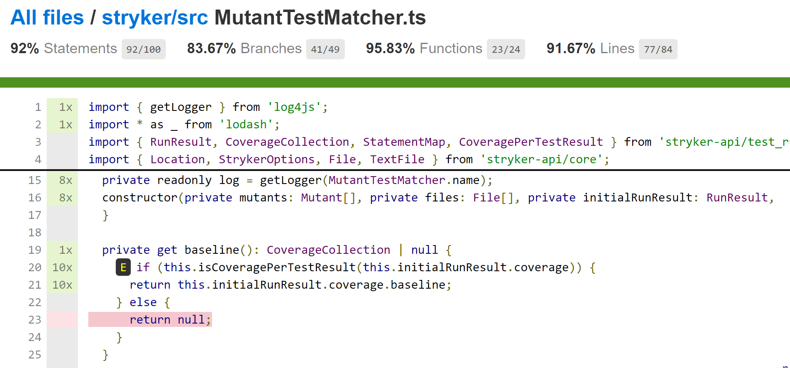

Slide 9
Unit testing
var user = { name: 'Simon', age: 24 };
// assert.equal(isOldEnough(user), true);

Slide 10


Slide 11


Slide 12
Mutation testing

Slide 13
Mutation testing
Testing your tests
Mutate source code to generate mutants
Run the tests to see if they still pass
Did any tests fail? Good! The mutant has been killed
No tests failed? The mutant survived!

Slide 14
Mutators
Original code | Mutated code
a > b | a < b
a > b | a >= b
a == b | a != b
if (a == b) | if (true)
i++ | i--
var list = [‘Hello’, ‘TechDays!’] | var list = [ ]
function doThings() { ……. } | function doThings() { }

Slide 15
Available frameworks
Use case | Framework
JavaScript/TypeScript | Stryker
Java | PITest
Ruby | Mutant
PHP | Humbug or Infection PHP
LLVM | Mull
C# | VisualMutator

Slide 16
Stryker
William Stryker: Mutants serve their purpose... as long as they can be controlled

Slide 17
Modern web development
Language? JavaScript, TypeScript, Babel, Flow, ...
Build system? Npm, Grunt, Gulp, Webpack, ...
Module loader? Webpack, SystemJS, ...
Test framework? Jasmine, Mocha, Tape, Jest, ...
Test runner? Karma, Mocha, Tape, Jest, ...

Slide 18


Slide 19
Stryker’s goals
Be easy to use
Be fast to run
Be extendable to fit your project

Slide 20
Easy
It’s easy! Just visit our homepage

Slide 21
Fast
Parallel test execution and transpilation
Async internally
Code coverage

Slide 22
Extendable
Test runner plugin
Test framework plugin
Mutator plugin
Transpiler plugin
Config writer plugin
Reporter plugin

Slide 23
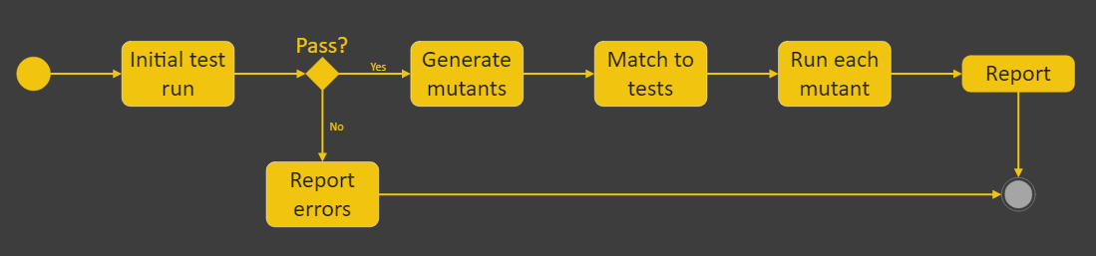
The Stryker proces

Slide 24

Thank You! Q&A Stand
#techdaysnl
#infosupport
Twitter
#techdaysnl #infosupport
stryker-mutator.github.io
Ask Guy!

